Slide 1

INTERVIEW PREAPARATION WEBSITE
GROUP 10
JIGAR PATEL - 0794004
DHRUMI PATEL- 0793770
BHAKTI BHATT - 0788808
SMIT ARORA - 0795650
VISMAY LAD - 0794141
Notes:
Links:
https://www.pexels.com/photo/photo-of-two-people-shakehands-2058130/

Slide 2
AGENDA
Project Initiation
Project Scope
Project Charter
Planning
Work Breakdown Structure
Execution
Monitoring And Controlling
Closure
RACI Matrix
Resource Work Activity Chart
Project Budget
Change Log
Schedule And Cost Control
Performing Quality Control

Slide 3
Project Initiation
The project's goal is to make it simple for job seekers to prepare for interviews with the help of subject-matter experts and interact with HR professionals.
The "interview preparation website" has 10 HR experts and more than 50 specialists in one stage.
Through videos and articles, they will share their insights on interview preparation.
Additionally, there will be an opportunity to speak with them privately online.
Notes:
Links:
https://www.pexels.com/photo/man-in-black-suit-jacket-standing-near-railings-3778876/

Slide 4

Project Scope
In Canada, almost 2 million people graduate from high school or college.
They then search for employment on various job-search websites and prepare for interviews.
Most of them are new to the job market for their particular field, consequently they don't have much experience with it.
To obtain their ideal career quickly, they require some appropriate counsel.
In addition, a significant proportion of students want to switch fields for a variety of reasons, yet many are unfamiliar with other fields.
So they may address such issue without tension thanks to our website.
STRENGTHS
Notes:
Links:
https://www.pexels.com/photo/person-holding-barbell-841130/
https://www.pexels.com/photo/human-fist-163431/

Slide 5
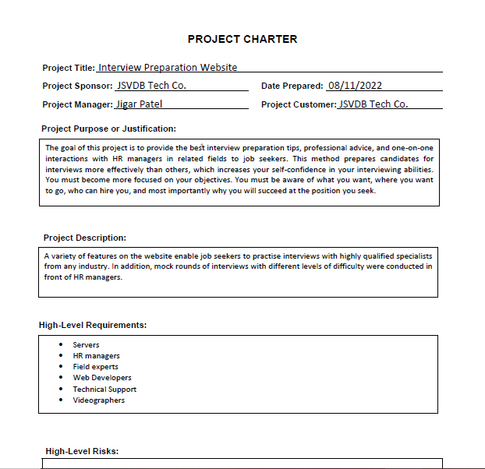
Project Charter

Slide 6

Project Charter
Project Charter is giving authority to Jigar Patel as Project Manager, JSVDB Tech Co. as Project Sponsor and Customer.
It also mentions the stakeholder panel, time, expected cost, risks, and requirements.

Slide 7
Planning
The work expectations and requirements are described, and the project plan is created, whenever the project plans are archived.
It includes the project scope, timetable, cost, work breakdown structure, and Gantt chart as well as the project plan.

Slide 8
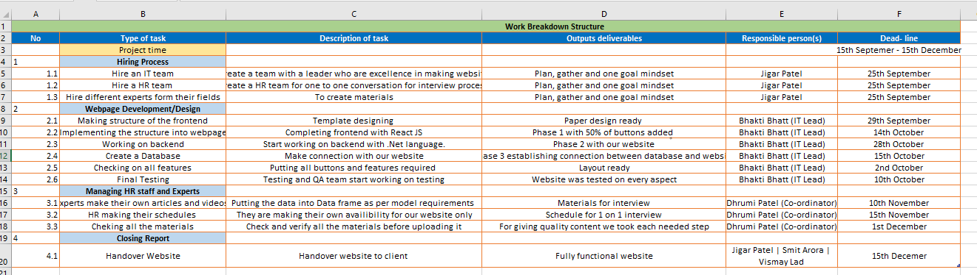
Work Breakdown Structure(WBS)

Slide 9
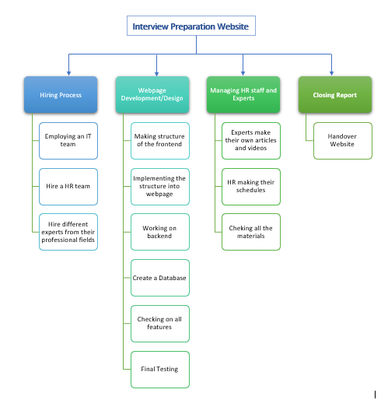
Work Breakdown Structure(WBS)

Slide 10
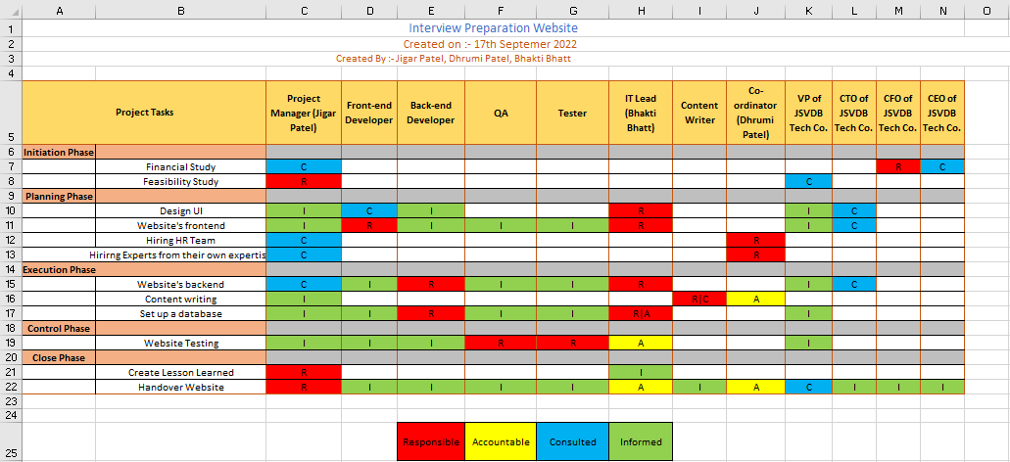
RACI Matrix

Slide 11
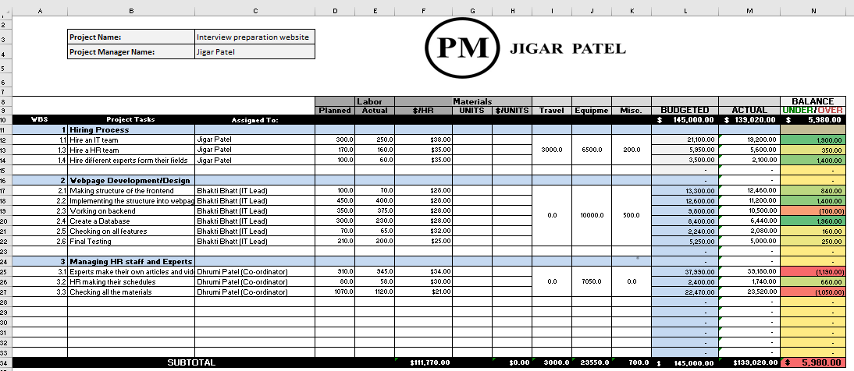
Project Cost & Budget

Slide 12
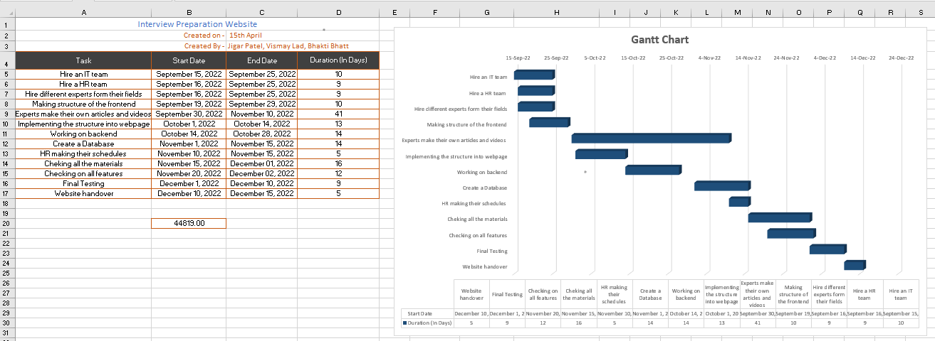
Resource Work Activities Chart

Slide 13
Execution
The point at which the arrangement put into place at earlier stages of the task's existence is put into motion.
Group completes all prescribed exercises, creates expectations, and communicates these to project partners.
For considerable progress, the team regularly collaborates with QA specialists and testers.

Slide 14
Monitoring and Controlling
Effectively assessing the situation as the project progresses, determining potential barriers, and implementing significant changes.
Change Id, Category, Description of the change, Submitted By, Submitted Date, Status, and Disposition are all saved in the change log record.

Slide 15
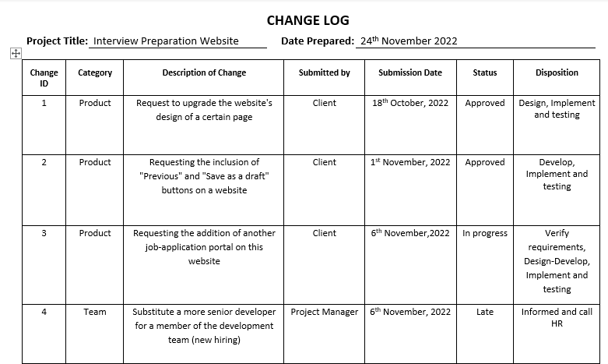
Change Log

Slide 16
Schedule control
During this time, the manager's job is to make sure the course plan exercises are proceeding as intended.
He should also keep an eye on any resource costs that are beyond the intended budget.
The management should also check to see if any of the active stakeholders are unable to complete tasks on time, causing the timeline to slip.
Schedule and cost control

Slide 17
Performing Quality Control
The website testing procedure meets the acceptance criteria established during quality planning. It consists of inspection.
Quality Requirements:
A bug-free website
Compatibility across all platforms
High-quality articles and videos

Slide 18
Closing
The process used for all project (including front-end and back-end) activities, phases, or contracts.
To ensure that every last detail has been addressed and that the project manager's efforts have been recognized.
Officially end all projects, tasks, activities, and phases.

Slide 19
THANK YOU
Notes:
This template is provided by https://www.free-power-point-templates.com/
Links:
https://www.pexels.com/photo/photo-of-two-people-shakehands-2058130/

